Slide 1
Introduction to MySQL

Slide 2
What is a database?
A database is a way of storing data.
Databases are specifically designed to be very efficient in storing and retrieving data.
The most common way of structuring data in a database is relational database system.

Slide 3
Relational databases
A relational database is a structured collection of tables.
Each table consists of rows called records.
Columns of the table have keys called fields. Each cell contains data.
Most tables have a special column that identifies the rows of the table. The values in this column are called primary keys.

Slide 4
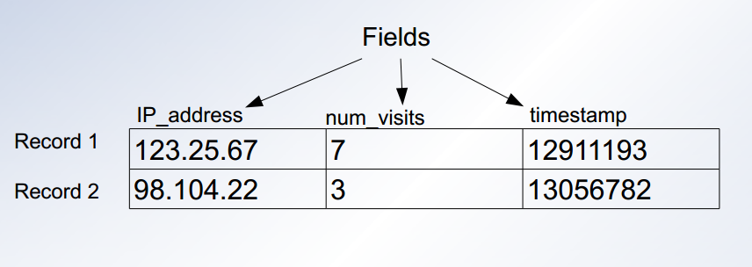
Relational database table example

Slide 5
What is SQL?
SQL stands for Structured Query Language.
It is a standard language developed for accessing and modifying relational databases.
SQL in turn is used by a database management system. Some common database management systems are:
MySQL
SQLite
PostgreSQL
Oracle
Microsoft SQL Server

Slide 6
MySQL
MySQL is free.
Very widely used.
Implements SQL database management.
Linux Red Hat already includes MySQL.
Facebook uses MySQL.

Slide 7
Basic MySQL commands
MySQL is case insensitive although field names are case sensitive.
MySQL commands end in a ; so if you do not end your command with a ; MySQL assumes you want to keep typing.

Slide 8
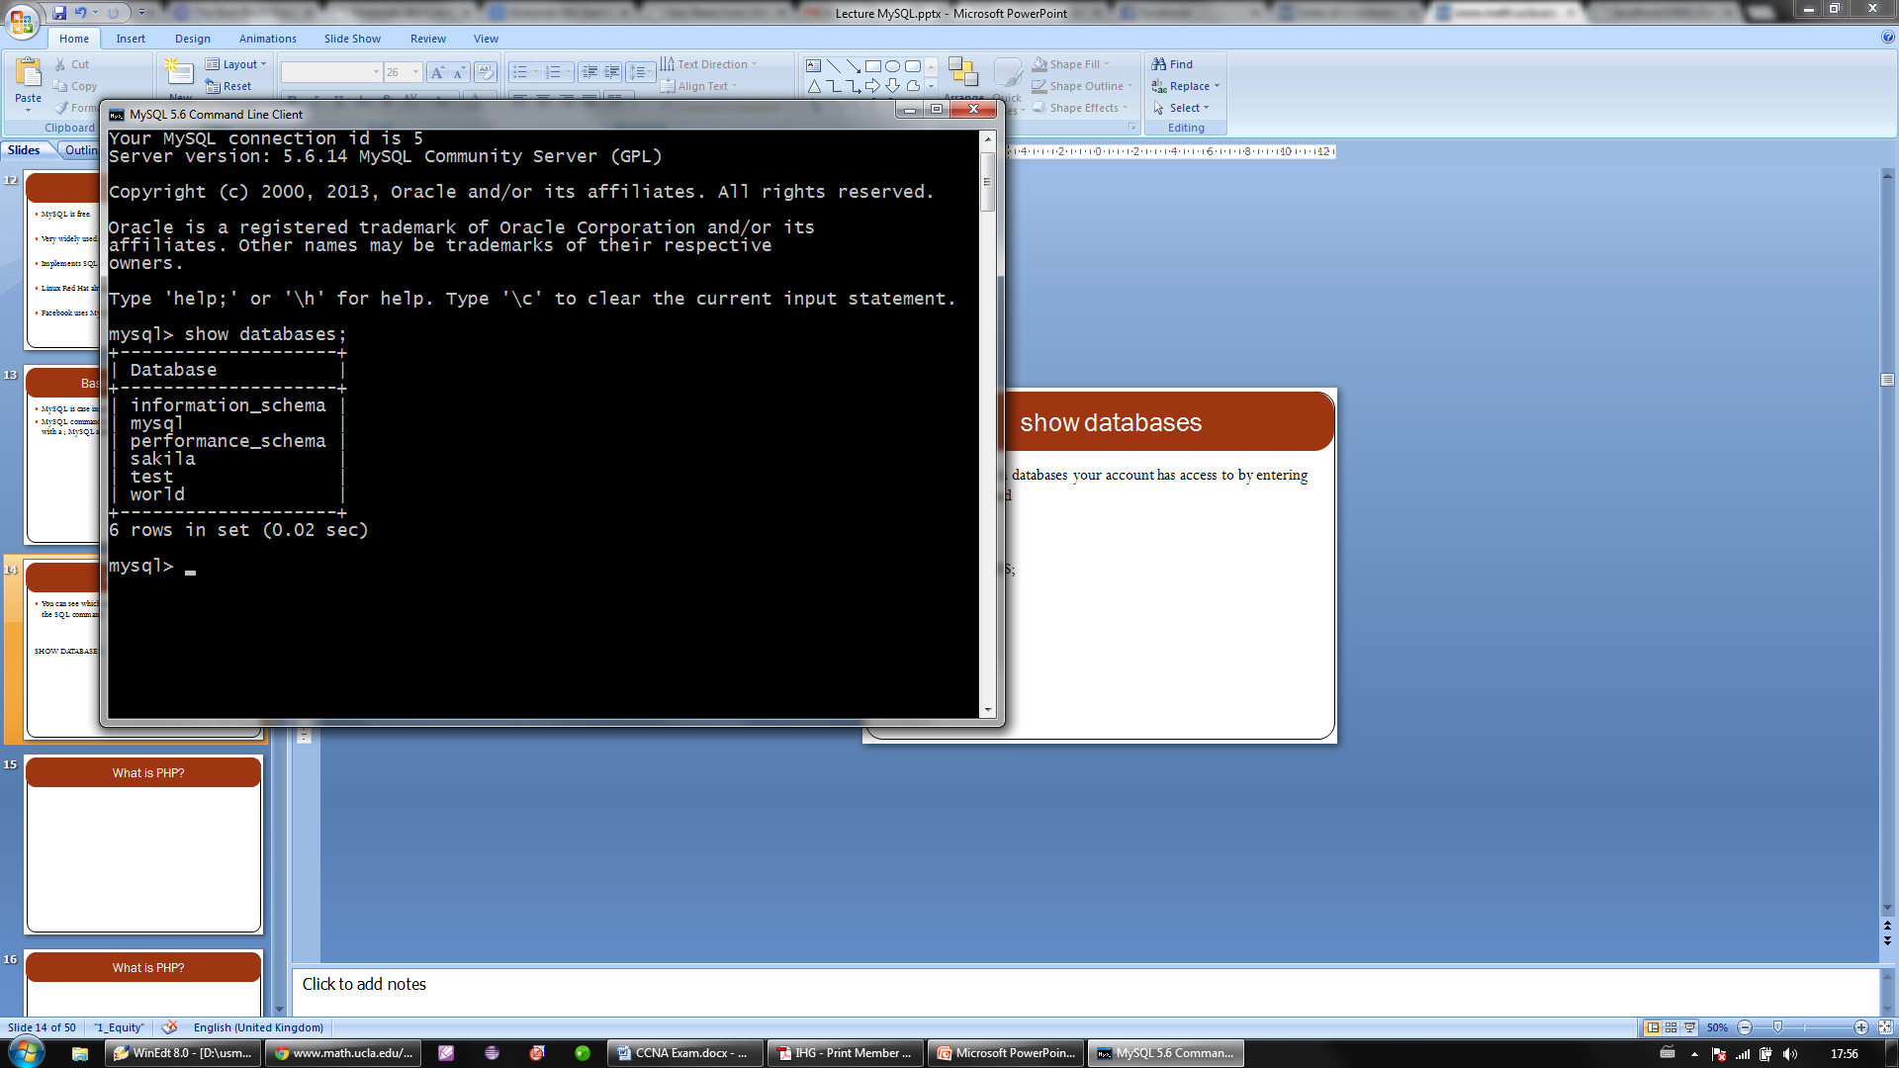
show databases
You can see which databases your account has access to by entering the SQL command
SHOW DATABASES;

Slide 9
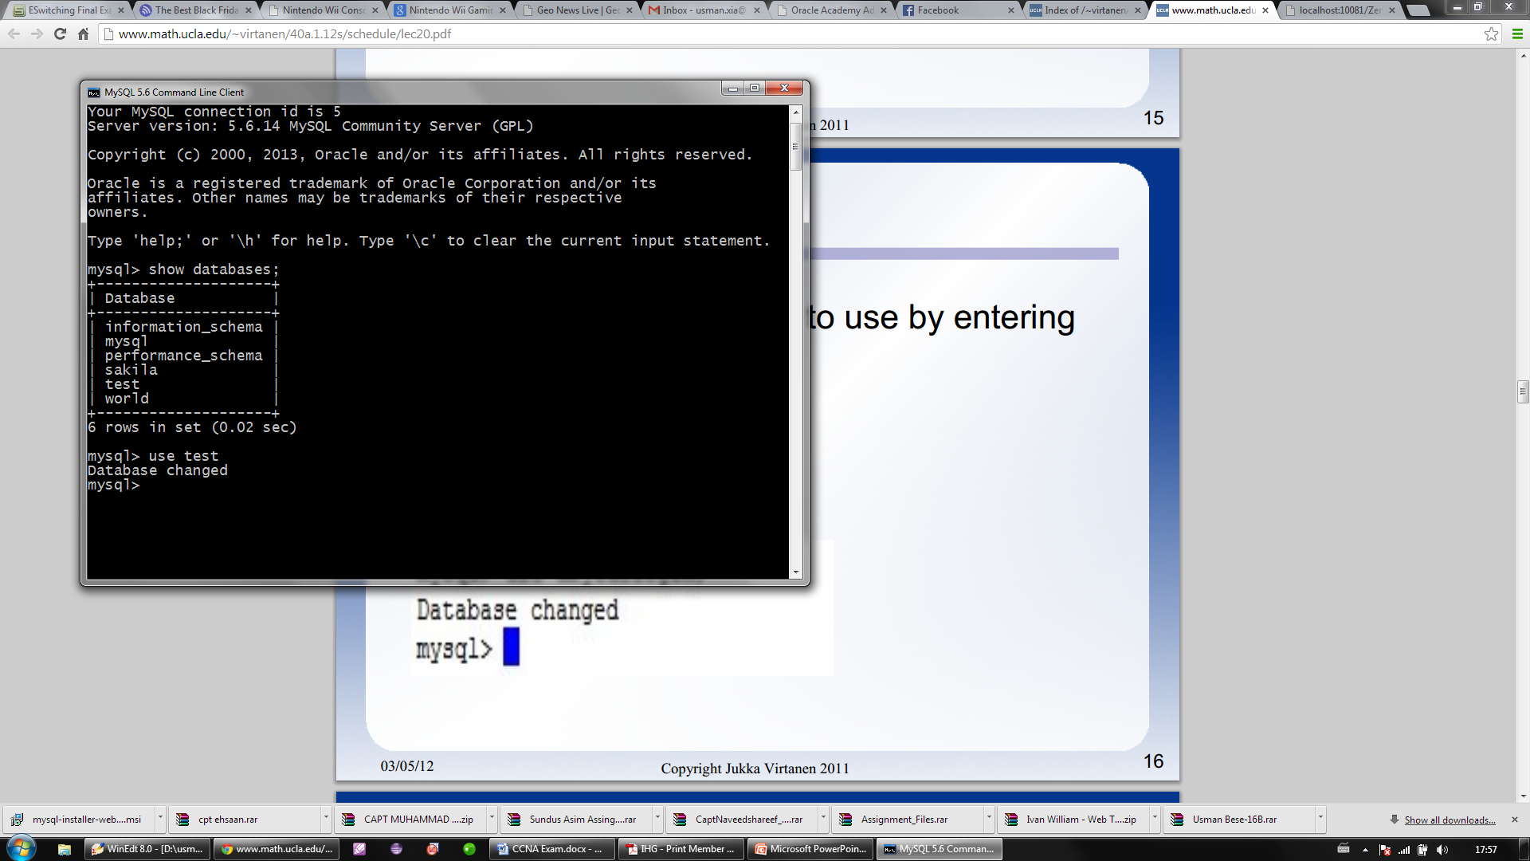
USE databasename;
You can select a database to use by entering the SQL command:
USE databasename;

Slide 10
SQL
At the MySQL prompt we can write in SQL instructions.
We will now learn more about the basic SQL commands.

Slide 11
CREATE TABLE
To create a new table we use the CREATE TABLE command.
Syntax for creating a new table is:
CREATE TABLE IF NOT EXISTS tablename (
fieldname1 type options default 'defaultvalue',
fieldname2 type options default 'defaultvalue',
...
);
There are number of possibilities for type including: varchar (or char) int, float(significant digits, digits after decimal).
After specifying type, you may specify the max length of the variable.
eg. varchar(10)

Slide 12
Example
CREATE TABLE IF NOT EXISTS students (
name varchar(100),
sid int(9),
gpa decimal(3,1),
phone varchar(12)
);

Slide 13
SELECT
Is used to ask for data from a table.
It tells the database to retrieve info from any number of tables and return it as a result set.
Syntax:
SELECT [fields here] FROM [tables here];
SELECT [fields here] FROM [tables here]
WHERE [condition here];

Slide 14
Example
Show all records from table "students" where the field called "name" has the value "Joe".
SELECT * FROM students WHERE name = "Joe";
Show all records from table "people" where the field called "name" has the value "Joe" AND the phone number "555-6789".
SELECT * FROM people WHERE name = "Joe" AND phone_number = "555-6789";

Slide 15
Example
Show all records from table "students" where the field called "name" has the value "Joe" OR "Bob".
SELECT * FROM students WHERE name = "Joe" OR name = Bob";
Show "student_id" and "name" fields from table "students" with GPA greater than or equal to 3.5.
SELECT sid, name FROM students WHERE GPA >= 3.5;

Slide 16
INSERT
Add a record to a table in a database.
Syntax:
INSERT INTO tablename (field1, field2, ...)
VALUES ('val1', 'val2', ...);
Example:
INSERT INTO students (name,sid,gpa,phone)
VALUES ('Zoidberg',77843211, -4.0,"N/A");

Slide 17
UPDATE
Modify an existing record in the database
Syntax:
UPDATE tablename SET fieldname = value WHERE
condition;
Example:
UPDATE students SET GPA ='3.8' WHERE person =
'Joe';

Slide 18
DELETE
Removes an existing record in a database
Syntax:
DELETE FROM tablename WHERE condition;
Example:
DELETE FROM students WHERE name="Fry";

Slide 19
Using PHP to run MySQL
Set up some variables so we are not hard coding anything.
$hostname = "laguna.pic.ucla.edu";
$username = "yourlogin";
$password = "PW1234";
$database = "dbyourlogin";
Connect and login to MySQLserver and store link to it as resource
$db = mysql_connect($hostname, $username, $password)
or die("Could not connect to database $database
$hostname.");
Select the database to access
mysql_select_db($database, $db);

Slide 20
INSERT
$table = "students";
$field1 = "name";
$field2 = "sid";
$field3 = "gpa";
$field4 = "phone";
$value1 = "Zoidberg";
$value2 = 123456789;
$value3 = -4.0;
$value4 = "N/A";
$sql= "INSERT INTO $table ($field1, $field2, $field3)
VALUES('$value1','$value2','$value3')";
$result = mysql_query($sql);

Slide 21
UPDATE
Define a MySQL query for updating records in a database table.
$newgrade= 3.1;
$newid= "222444888";
$sql= "UPDATE $table SET $field2 ='$newid',
$field3 = '$newgrade' WHERE $field1='$value1'";
$result = mysql_query($sql);

Slide 22
DELETE
Define a MySQL query for deleting records from a table in a database.
$sql= "DELETE FROM $table WHERE $field1 = 'Fry'";
$result = mysql_query($sql);

Slide 23
SELECT
$sql= "SELECT $field1, $field2, $field3 FROM $table
WHERE $field3 = '4.0'";
$result = mysql_query($sql);
Now the result is potentially many records and we have to have a
way to parse data from this result.

Slide 24
SELECT
We use mysql_fetch_array to extract one record from the result. It works a lot like the next function we used for arrays.
while($record= mysql_fetch_array($result))
{
print " <tr>\n";
print " <td>" . $record[$field1]. "</td>\n";
print " <td>" . $record[$field2]. "</td>\n";
print " <td>" . $record[$field3]. "</td>\n";
print " </tr>\n";
}
Note: $record is an array where keys are the fields. Corresponding values are the data.

Slide 25
mysql_num_rows
To figure out how many (if any) records SELECT found we can use mysql_num_rows($result).
$num_records = mysql_num_rows($result);

Slide 26
SELECT
We use mysql_fetch_array to extract one record from the result. It works a lot like the next function we used for arrays.
while($record= mysql_fetch_array($result))
{
print " <tr>\n";
print " <td>" . $record[$field1]. "</td>\n";
print " <td>" . $record[$field2]. "</td>\n";
print " <td>" . $record[$field3]. "</td>\n";
print " </tr>\n";
}
Note: $record is an array where keys are the fields. Corresponding values are the data.

Slide 27
Database CRUD
Explanation: The acronym CRUD represents the most common SQL operations performed on a database.
Letter | Operation | MySQL Statement
C | Create | INSERT
R | Retrieve | SELECT
U | Update | UPDATE
D | Destroy | DELETE

Slide 28
SQL Data Manipulation (Select)
Description: The following are the most often used SQL data commands.
SELECT: Querying data in a database.
INSERT: Adding data to tables.
UPDATE: Modifying existing table data.
DELETE: Removing rows from tables.
28

Slide 29
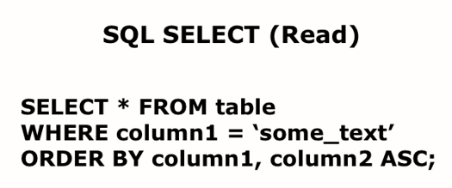
Querying Table Data
SELECT: Used for extracting data contained in a table.
Syntax:
29

Slide 30
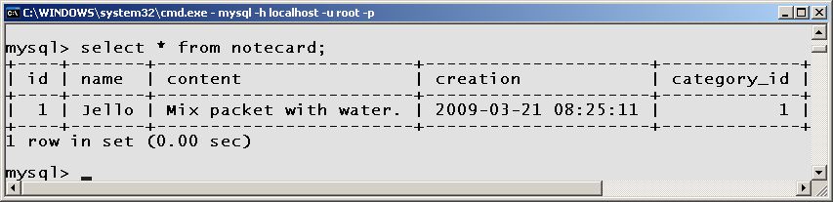
Examining Table Values
Description: The asterisk (*) can be used as a wildcard to specify all the columns in a query.
Example:
SELECT * FROM recipe LIMIT 1;
30

Slide 31
Select Examples
/* display all columns and all rows */
SELECT * FROM recipe;
/* column names specified */
SELECT name, content
FROM recipe;
/* specify matching row(s) */
SELECT * FROM recipe
WHERE name = "Jello";
/* sort according to name */
SELECT * FROM recipe ORDER BY name;
/* obtain most recent recipe */
SELECT id FROM recipe ORDER BY creation
DESC LIMIT 1;
The LIMIT clause can be used to constrain the number of rows returned by the SELECT statement.
31

Slide 32
Joining Tables Theory
recipe
id | name | category_id
1 | Jello | 2
2 | Pudding | 2
3 | Koolaid | 1
category
id | name
1 | Beverage
2 | Dessert
Often multiple tables are combined to obtain the information required. The tables are “joined” via the where clause.
32

Slide 33
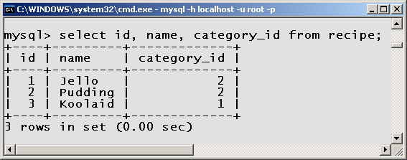
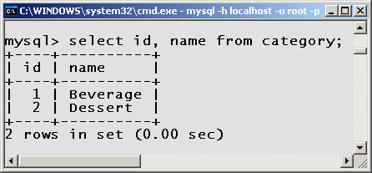
Joining Tables Example
SELECT recipe.name, category.name FROM recipe, category WHERE category_id = category.id;
33

Slide 34
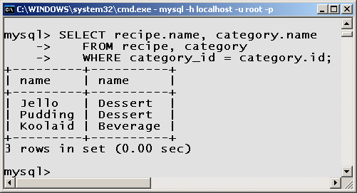
Joining Tables Results
Foreign Key
Primary Key
Note: The column “id” in the category table is called a primary key. The column “category_id” in the “recipe” table is called a “foreign key”. The two tables are joined together by linking the primary and foreign keys.
34

Slide 35
Selecting Unique Values
Description: A select statement may result in duplicate row values. Unique rows can be obtained by using the DISTINCT key word.
Syntax:
SELECT DISTINCT col1 [, ...]
FROM tbl1 [, ...]
[WHERE condition]
[ORDER BY col1 [, ...]
[LIMIT n];
35

Slide 36
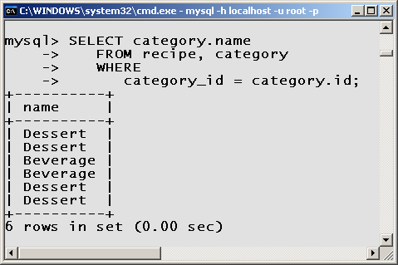
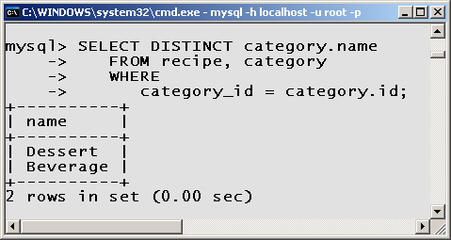
Select Distinct Example
36

Slide 37
Table Aliases
A table alias is an alternative name (often abbreviated) which references a table.
Table Alias Example:
SELECT *
FROM recipe AS r,
category AS c
WHERE r.category_id = c.id;
Note: “r” alias for table “recipe” “c” alias for table “category”
37

Slide 38
Column Aliases
A column alias is an alternative abbreviated name of which to reference a column.
Column Alias Example:
SELECT r.name AS 'Title',
c.name AS 'Type'
FROM recipe AS r,
category AS c
WHERE r.category_id = c.id
ORDER BY 'Title';
Note: “Title” alias for column “recipe.name” “Type” alias for column “category.name”
38

Slide 39
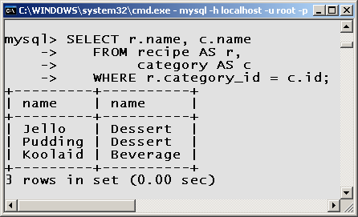
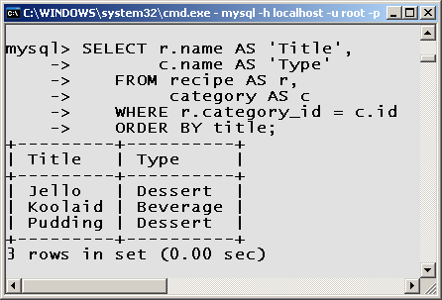
Column Aliases Example
39

Slide 40
SQL Data Manipulation (Insert)
Description: The following are the most often used data modification commands.
SELECT: Querying data in a database.
INSERT: Adding data to tables.
UPDATE: Modifying existing table data.
DELETE: Removing rows from tables.
40

Slide 41
Adding New Data
INSERT: Used for creating a new row of data in a table.
Syntax:
INSERT INTO table
[(column1, ... )]
VALUES (value1, ...);
41

Slide 42
Insert Rules
If columns are not specified, values must be in the same order in which they were defined (via CREATE command).
Numeric values should not be quoted.
String values must be quoted.
Date and time values should be quoted.
42

Slide 43
Insert Rules (cont.)
SQL functions should not be uoted.
NULL should never be quoted.
If a value is not specified, the value inserted is NULL, unless a default column value has been defined or column attribute is AUTO_INCREMENT.
Quoting a column name is optional.
43

Slide 44
Inserting Without Columns Specified
Example:
INSERT INTO recipe
VALUES (
NULL, # id
"Jello", # name
"Add water", # content
NULL, # creation
2 ); # category_id
Note: Values must be specified in the order which the columns were created. No columns can be skipped. Every column must have a value or NULL.
44

Slide 45
Inserting With Columns Specified
Example:
INSERT INTO notecard
# COLUMNS
( name,
content,
category_id )
VALUES
( "Pudding", # name
"Add milk.", # content
2 ); # category_id
Note: The order of the column names must match the order of the values.
45

Slide 46
Obtaining the ID of the last record
Worst Solution:
SELECT COUNT(id) FROM RECIPE;
Poor Solution:
SELECT MAX(id) FROM RECIPE;
Good Solution:
SELECT id FROM recipe ORDER BY
creation DESC LIMIT 1;
Best Solution:
SELECT LAST_INSERT_ID();
46

Slide 47
SQL Data Manipulation (Update)
Description: The following are the most often used data modification commands.
SELECT: Querying data in a database.
INSERT: Adding data to tables.
UPDATE: Modifying existing table data.
DELETE: Removing rows from tables.
47

Slide 48
Modifying Data
UPDATE: Used for modifying existing table data.
Syntax:
UPDATE tableName
SET colName = newValue
[WHERE colName = const]
[LIMIT n];
Pitfall: Failing to specify the WHERE or LIMIT clause modifies all the records in the table!
Note: There is no “undo” on inadvertently modified data.
48

Slide 49
Update Examples
Examples:
/* modify column 'content' on all rows */
UPDATE recipe
SET content = "Mix ingredients";
/* replace "Drink" with "Beverage" (1st match) */
UPDATE category
SET name = "Beverage"
WHERE name = "Drink“
LIMIT 1;
/* modify via unique id (most common) */
UPDATE recipe
SET content = "Stir ingredients";
WHERE id = 1;
49

Slide 50
SQL Data Manipulation (Delete)
Description: The following are the most often used data modification commands.
SELECT: Querying data in a database.
INSERT: Adding data to tables.
UPDATE: Modifying existing table data.
DELETE: Removing rows from tables.
50

Slide 51
Deleting Data
Delete: Used for removing row(s) in a table.
Syntax:
DELETE FROM tableName
[WHERE colName = const]
[LIMIT n];
Pitfall: Failing to specify the WHERE or LIMIT clause deletes all the records in the table!
Note: There is no “undo” on deleted data.
51

Slide 52
Delete Examples
Examples:
/* delete all rows (you sure?) */
DELETE FROM book;
/* delete the first match */
DELETE FROM book
WHERE lastName = "Wesley"
LIMIT 1;
/* delete via id (most common) */
DELETE FROM book
WHERE id = 1;
52

